Slide 1
Lookup functions in spreadsheets
Paul kisambira
pkisambira@ucu.ac.ug

Slide 2
What is VLOOKUP?
Vlookup (V stands for 'Vertical') is an in-built function in excel/libre office calc which allows establishing a relationship between different columns of excel.
In other words, it allows you to find (look up) a value from one column of data and returns it's respective or corresponding value from another column.

Slide 3
outline
Usage of VLOOKUP:
Steps for Applying the VLOOKUP function
VLOOKUP for Approximate Matches (TRUE Keyword as the last parameter)
Vlookup function applied between 2 different sheets placed in a same workbook

Slide 4
Usage of VLOOKUP:
When you need to find some information in a large data-spreadsheet, or you need to search for the same kind of information throughout the spreadsheet use the Vlookup function.
Let's take an instance of Vlookup as:
Company Salary Table which is managed by the financial team of the Company – In Company Salary Table, you start with a piece of information which is already known (or easily retrieved). Information that serves as an index.

Slide 5
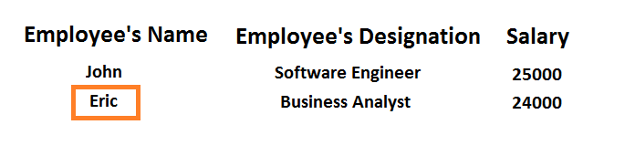
So as an Example:
You start with the information which is already available:
(In this Case, Employee's Name)

Slide 6
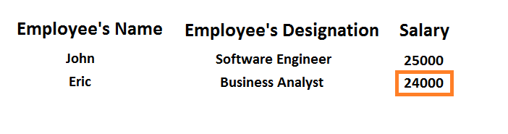
To find the information you don't know:
(In this case, we want to look up for Employee's Salary)

Slide 7
In the spreadsheet you downloaded, to find out the Employee Salary which we don know -
We will enter the Employee Code which is already available.

Slide 8
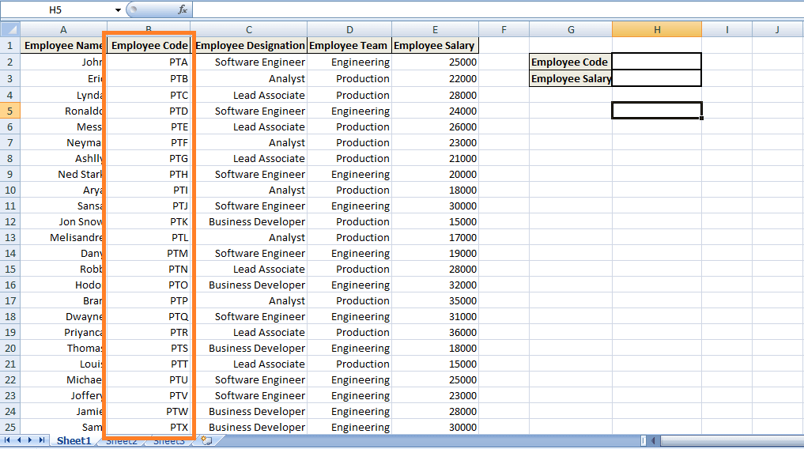

Slide 9
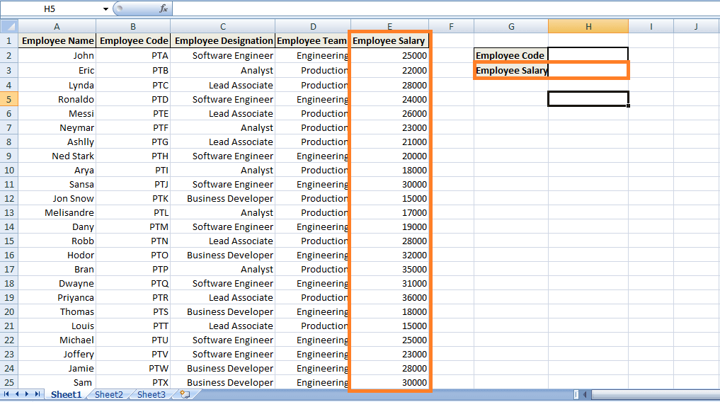

Slide 10
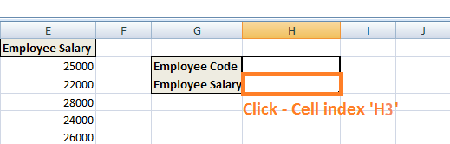
Steps for Applying the VLOOKUP function
Step 1) we need to navigate to the cell where you want to view the Salary of the particular Employee.- (in this instance, Click the cell with index 'H3’)

Slide 11
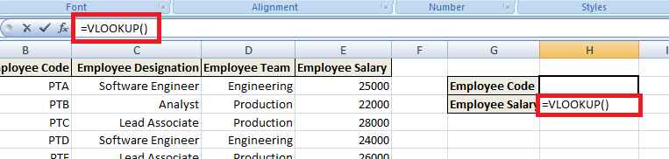
Step 2) Enter the VLOOKUP Function in the Cell: Start with an equal sign which denotes that a function is entered, 'VLOOKUP' keyword is used after the equal sign depicting VLOOKUP function =VLOOKUP ()
The parenthesis will contain the Set of Arguments (Arguments are the piece of data that function needs in order to execute).

Slide 12
Step 3) First Argument: the first argument would be the cell reference (as the placeholder) for the value that needs to be searched or the lookup value. Lookup value refers to the data which is already available or data which you know.
(In this case, Employee Code is considered as the lookup value so that the first argument will be H2, i.e., the value which needs to be looked up or searched, will be present on the cell reference 'H2').

Slide 13
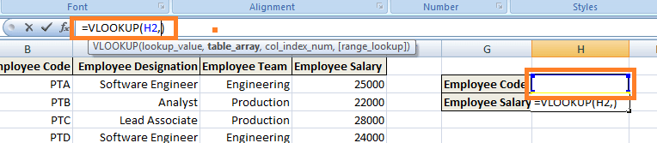

Slide 14
Step 4) Second Argument: It refers to the block of values that are needed to be searched.
In Excel/libreoffice calc, this block of values is known as table array or the lookup table. In our instance, the lookup table would be from cell reference B2 to E25,i.e., the complete block where the corresponding value would be searched.

Slide 15
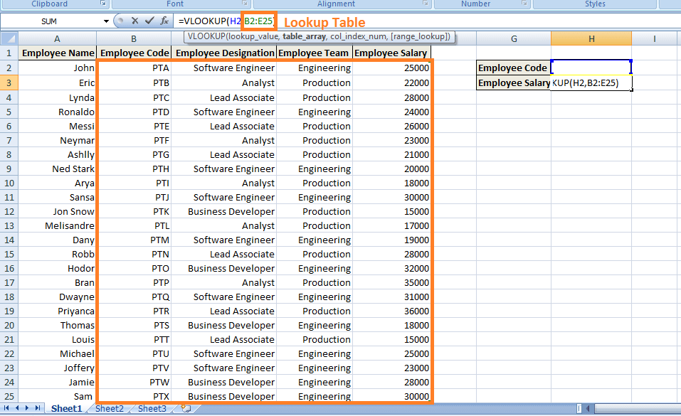

Slide 16
Step 5) Third Argument: It refers to the column reference. In other words, it notifies VLOOKUP where you expect to find the data, you want to view. (Column reference is the column index in the lookup table of the column where the corresponding value ought to be found.) In this case, the column reference would be 4 as the Employee's Salary column has an index of 4 as per the lookup table.

Slide 17
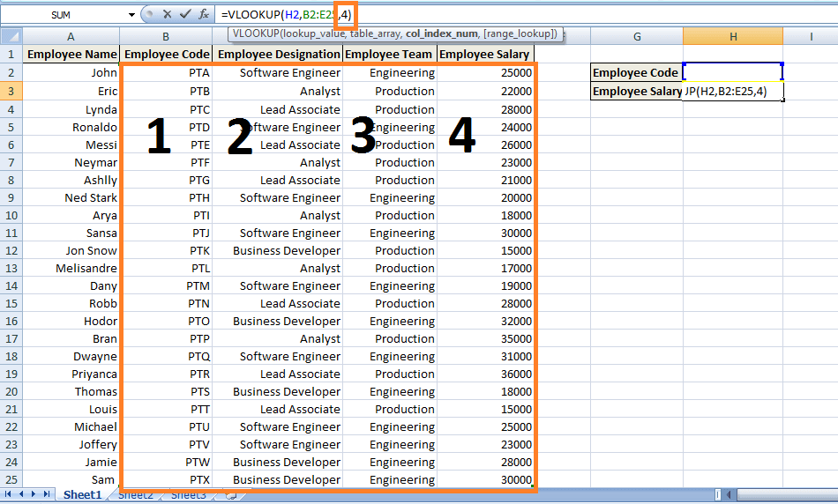

Slide 18
Step 6) Fourth Argument: The last argument is range lookup. It tells the VLOOKUP function whether we want the approximate match or the exact match to the lookup value. In this case, we want the exact match ('FALSE' keyword).
FALSE: Refers to the Exact Match.
TRUE: Refers for Approximate Match.

Slide 19
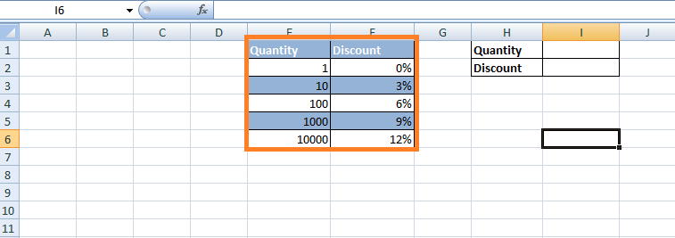
VLOOKUP for Approximate Matches (TRUE Keyword as the last parameter)
Consider a scenario where a table calculates discounts for the customers who do not want to buy exactly tens or hundreds of items.
As shown below, certain Company has imposed discounts on the quantity of items ranging from 1 to 10,000:

Slide 20
Now it is uncertain that the customer buys exactly hundreds or thousands of items.
In this case, Discount will be applied as per the VLOOKUP's Approximate Matches. In other words, we do not want to limit them for finding matches to just the values present in the column that are 1, 10, 100, 1000, 10000. Here are the steps:

Slide 21
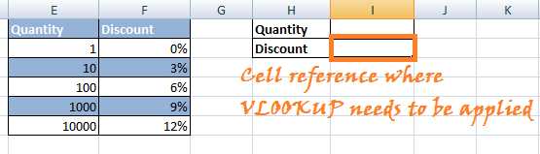
Step 1) Click on the cell where the VLOOKUP function needs to be applied i.e. Cell reference 'I2’.

Slide 22
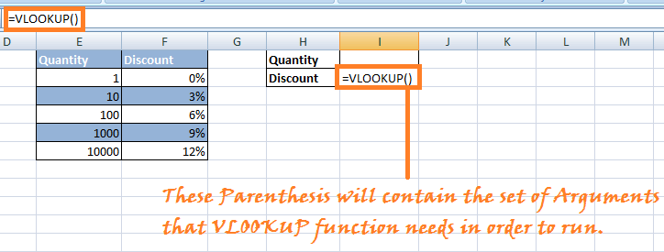
Step 2) Enter '=VLOOKUP()' in the cell. In the parenthesis enter the set of Arguments for the above instance.

Slide 23
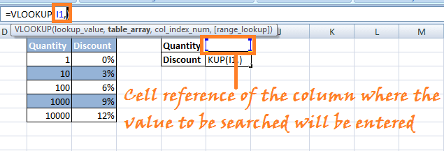
Step 3) Enter the Arguments:
Argument 1: Enter the Cell reference of the cell at which the value present will be searched for the corresponding value in the lookup table.

Slide 24
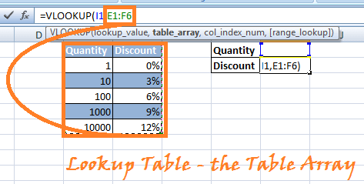
Step 4) Argument 2: Choose the lookup table or the table array in which you want VLOOKUP to search for the corresponding value.(In this case, choose the columns Quantity and Discount)

Slide 25
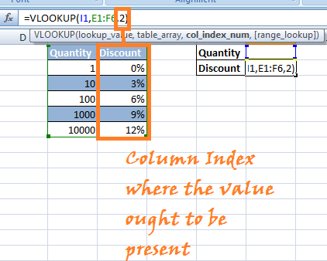
Argument 3: The third argument would be the column index in the lookup table you want to be searched for the corresponding value.

Slide 26
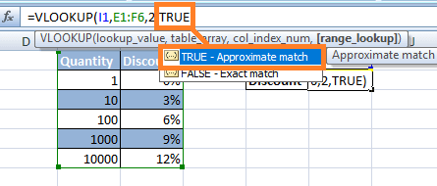
Step 5) Argument4: Last argument would be the condition for Approximate Matches or Exact Matches. In this instance, we are particularly looking for the Approximate matches (TRUE Keyword).

Slide 27
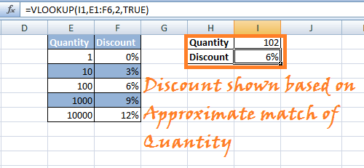
Step 6) Press 'Enter.' Vlookup formula will be applied to the mentioned Cell reference, and when you enter any number in the quantity field, it will show you the discount imposed based on Approximate Matches in VLOOKUP.

Slide 28
NOTE: If you want to use TRUE as the last parameter, you can leave it blank and by default it chooses TRUE for Approximate Matches.

